Slide 1


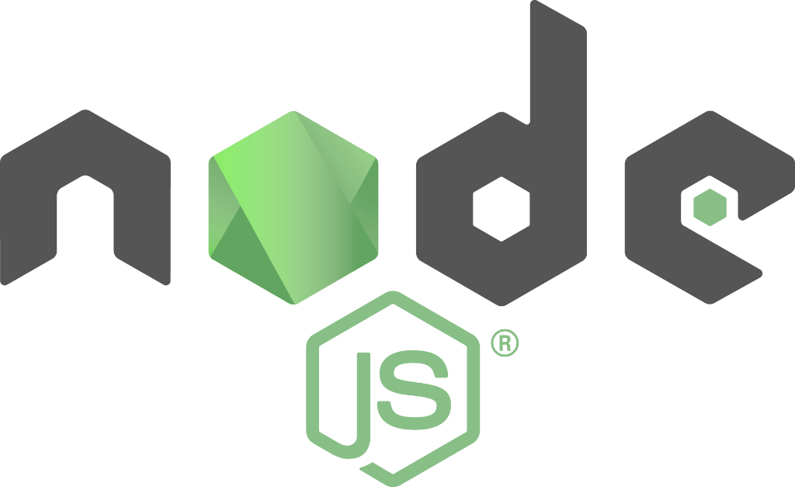

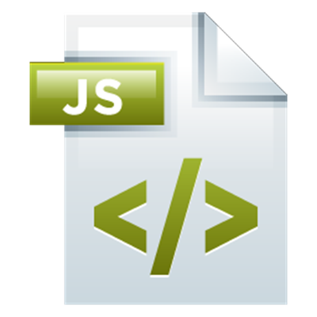
Introduction to Node.js
History and Basic Components
Node.js Intro
SoftUni Team
Technical Trainers
Software University
http://softuni.bg

Slide 2


Table of Contents
Overview of Node.js
IDE setup
Node Event Loop
Modules
Basic Web Server

Slide 3
Have a Question?
sli.do #express-js

Slide 4
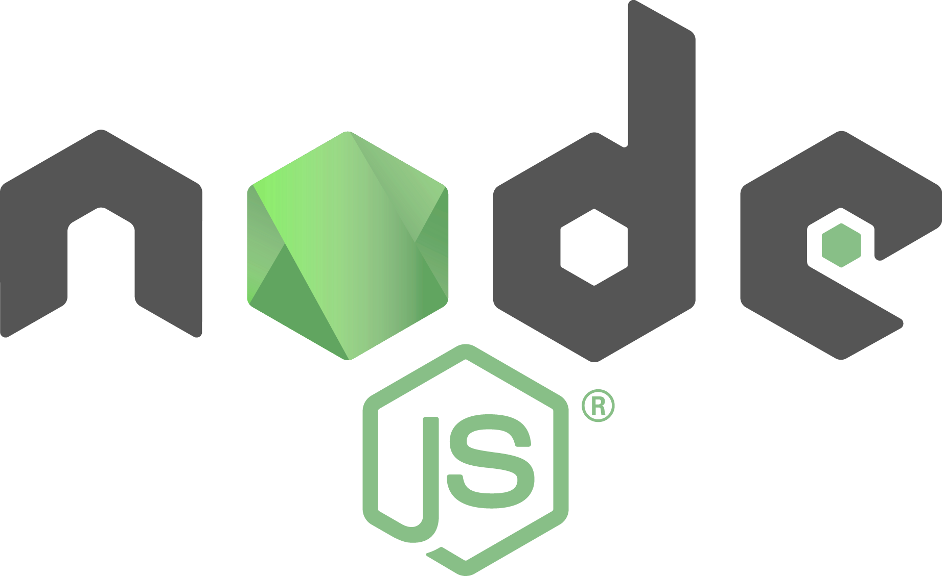
Overview of Node.js
History, Components, Installation

Slide 5
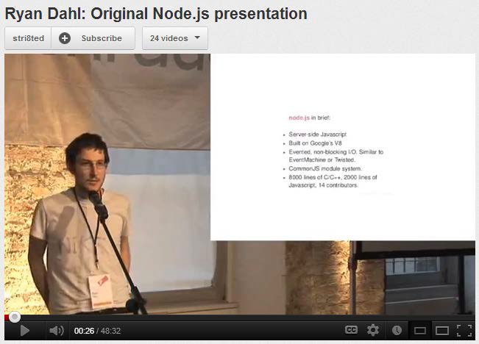

Overview of Node.js
History and Components
Created in 2009 by Ryan Dahl
Addresses the issues of then popular servers
V8, Event Loop, libuv
Advantages
One language for server and client
Fast and asynchronous
Efficient package manager

Slide 6
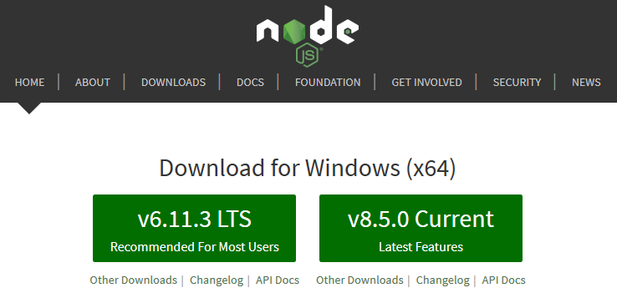
Installation
Installation
Go to http://nodejs.org
To confirm installation, type in command prompt (terminal):
node -v

Slide 7
How to Use
From the terminal
Interpret code from a file
Save script to index.js
Execute from the terminal:
node // Start REPL
let a = 5
let b = 3
a + b // 8
node index.js // 8

Slide 8
NPM Packages
Node.js projects are usually set up as NPM packages
From the terminal, inside the target directory :
Answer questions to initialize project
A package.json file will be created with initial configuration
To bypass all questions (take default values):
npm init
npm init -y

Slide 9
Configuration (package.json)
{
"name": "demo",
"version": "1.0.0",
"description": "Node.js demo project",
"main": "index.js",
"engine": "8.5.0",
"scripts": {
"start": "node index.js"
},
"keywords": [],
"author": "",
"license": "ISC“
}
Target version on the server
Aliases for executing
node commands

Slide 10
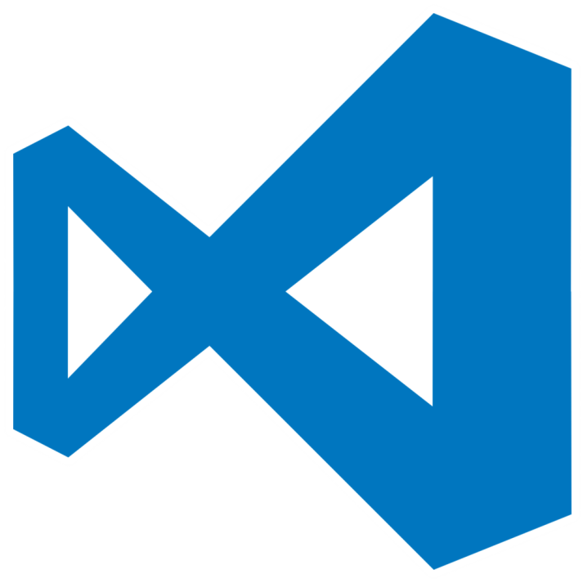




IDE Setup
Development Environments for Node.js

Slide 11
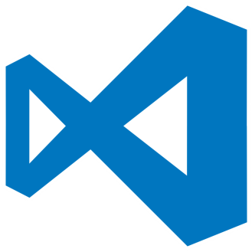


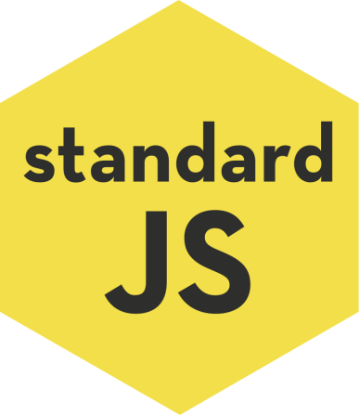
Configuring Visual Studio Code
Download from https://code.visualstudio.com/
Official Node.js instructions can be found at:
Recommended linters:
https://code.visualstudio.com/docs/runtimes/nodejs

Slide 12
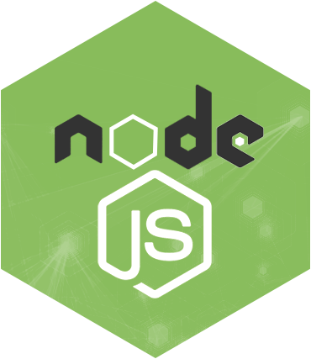
The Event Loop
The Core Node Component

Slide 13


The Event Loop
Long-running processes
Order of completion
is not guaranteed

Slide 14
Stack Execution
The Stack
The Heap
function

Slide 15
Stack Execution
The Stack
The Heap
function
function
function
Function call
Execution returns

Slide 16
Stack Execution
The Stack
The Heap
Program finished

Slide 17
The Event Loop
The Stack
The Heap
function
function
function
Event Queue
event
Event placed in the queue

Slide 18
The Event Loop
The Stack
The Heap
Execution stack
is empty
function
function
function
Event Queue
event

Slide 19
The Event Loop
The Stack
The Heap
Event callback is executed
function
Event Queue
event

Slide 20
Asynchronous Code
The synchronous way
Operations are
carried out in order
var conn = getDbConnection(connectionString);
var stmt = conn.createStatement();
var results = stmt.executeQuery(sqlQuery);
for (var i=0; i<results.length; i++) {
// print results[i];
}

Slide 21
Asynchronous Code
The Node.js asynchronous way
Callbacks are invoked when the result is ready
getDbConnection(connectionString, function (err, conn) {
conn.createStatement(function (err, stmt) {
var results = stmt.executeQuery(sqlQuery);
results.on('row', function(result) {
// print result
});
});
});
…
Code execution continues
while waiting for response

Slide 22
Conventions
The function callback is the last parameter in the call
Error is the first parameter in the callback
Always check errors and handle them correctly!
function handleResults (error, results) {
// if error is undefined…
// do something with the results
}
getStuff(inputParam, handleResults);
Callback
Calling function

Slide 23
Asynchronous Code in ES6
Allows asynchronous code to be composed like it is synchronous
Requires Node.js version 7.6.0 to work
let conn = await getDbConnection(connectionString);
let stmt = await conn.createStatement();
let results = await stmt.executeQuery(sqlQuery);
for (let result of results) {
// print result;
}

Slide 24
Using Modules
Making Our App Modular

Slide 25
What is a Module?
persons.js
class Person {
constructor(name) {
this.name = name;
}
toString() {
return `I'm ${this.name}`;
}
}
module.exports = Person;
app.js
let Person = require('./person');
let p = new Person('Pesho');
console.log(p.toString());

Slide 26
How To Use Modules
Modules allow larger apps to be split and organized
To expose a module
To use a module from another file
module.exports = Person;
module.exports = { getById, getAll, update };
let Person = require('./Person');
let api = require('./api');
let getById = require('./api').getById;
let { getById } = require('./api');

Slide 27
Built-in Modules
Node.js comes with a plethora of useful modules
Imported with a string identifier
Commonly used modules
fs, http, crypto, os
More at https://nodejs.org/api/
var fs = require('fs');

Slide 28
Your Modules
first.js
var count = 2;
var doIt = function(i, callback) { … }
module.exports.doIt = doIt;
module.exports.someVar = 'result';
second.js
var one = require('./first');
one.doIt(23, function (err, result) {
console.log(result);
});
console.log(one.someVar);
console.log(one.count); // invalid

Slide 29
Third-Party Modules
Installed from Node Package Manager (NPM)
Run from the terminal
To use in your code
To install globally (for use from the terminal)
npm install --save express --save-exact
let express = require('express');
npm install --g mocha

Slide 30
Node.js Web Server
Let's start the fun!

Slide 31
What Do the Web Servers Do? (Again)
All physical servers have hardware
The hardware is controlled by the operating system
Web servers are software products that use the operating system to handle web requests
Web servers serve Web content
These requests are redirected to other software products (ASP.NET, PHP, etc.), depending on the web server settings

Slide 32
A Simple Node.js Web Server
Let's write a simple Node.js web server
const http = require('http')
http.createServer((req, res) => {
res.write('Hi!')
res.end()
}).listen(1337)
console.log('Node.js server running on port 1337')

Slide 33
Summary
Node.js is a fast, asynchronous back-end platform
The JavaScript Event Loop runs slow tasks in the background asynchronously
You can organize your code with modules
NPM allows quick access to external modules
let express = require('express');
npm init -y
npm install --save socket.io

Slide 34







Introduction to Node.js
https://softuni.bg/courses/

Slide 35
License
This course (slides, examples, demos, videos, homework, etc.) is licensed under the "Creative Commons Attribution-NonCommercial-ShareAlike 4.0 International" license
Attribution: this work may contain portions from
"End-to-end JavaScript Applications" course by Telerik Academy under CC-BY-NC-SA license

Slide 36





Trainings @ Software University (SoftUni)
Software University – High-Quality Education, Profession and Job for Software Developers
softuni.bg
Software University Foundation
http://softuni.foundation/
Software University @ Facebook
facebook.com/SoftwareUniversity
Software University Forums
forum.softuni.bg

